Slide 1
DevOps for Systems of Record
An experience Report

Slide 2

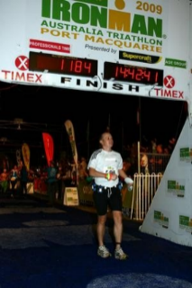

This is me…
Mirco Hering
DevOps and Agile Lead in APAC
Over 10 years of experience improving IT delivery through automation, methodology and innovation
Mainly worked on very large clients
Certified CSM, SAFe Agilist, Master Technology Architect
Conference Speaker and Blogger
Massive football (European) fan
Outside of work: Travel, Tennis, Triathlon
Follow me on Twitter: @mircohering
Or read my blog: http://notafactoryanymore.com

Slide 3
What you will hopefully learn today
The importance of COTS and other systems of record for your DevOps journey
3 simple steps to start the DevOps journey for systems of records
What to do with COTS code
Benefits achieved in real life
Challenges along the way
@mircohering / http://notafactoryanymore.com

Slide 4
Systems of Record – what is that?
Systems of Record
Or shall we call it: Legacy
Or be nice about it and call it: Enterprise
It doesn’t matter – I mean those systems that don’t play nicely: Packaged Software, Non-Custom code or older custom code that behaves like a package,…
Think – Siebel, SAP, Mainframe,…
@mircohering / http://notafactoryanymore.com

Slide 5

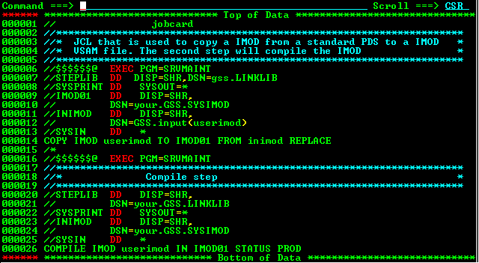

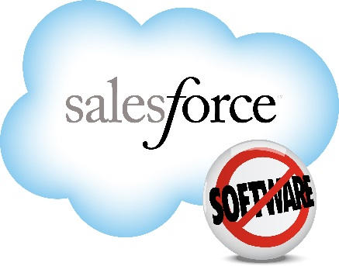
Is this your world….
@mircohering / http://notafactoryanymore.com

Slide 6

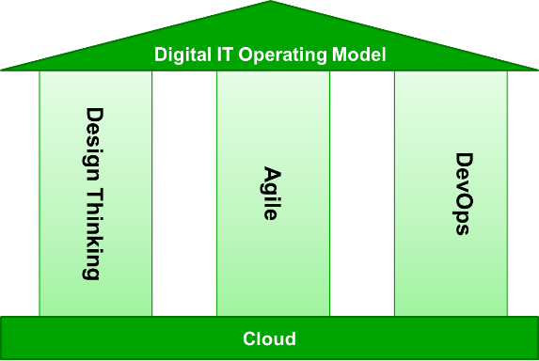
Two-Speed IT is an intermediate step, but you should not forget the enterprise applications
Both digital and enterprise applications must move faster to keep pace
Digital Applications
Enterprise Applications
Read more on my blog:
http://notafactoryanymore.com/2015/01/28/how-to-support-multi-speed-it-with-devops-and-agile/
@mircohering / http://notafactoryanymore.com

Slide 7
The Legacy Complication…
- Today -
- Tomorrow -
Front
Channels & Customer Experience
“High Speed Agility”
Typical project
Channels & Customer Experience
DECOUPLING
Core Services
Back
Core Services
“Low Speed Stability”
Partners
@mircohering / http://notafactoryanymore.com

Slide 8

My view of DevOps
DevOps is a direction, not a goal!
@mircohering / http://notafactoryanymore.com

Slide 9

So what can we do with systems of record
Continuous Delivery
Cloud Environment Provisioning
Environment Management & Monitoring
Test Automation
Build & Deployment Automation
Software Configuration Management
Project Management Tooling
Cultural Change & Organization Alignment: Agile Business Mindset
@mircohering / http://notafactoryanymore.com

Slide 10
Is it technology or culture that holds us back?
@mircohering / http://notafactoryanymore.com

Slide 11
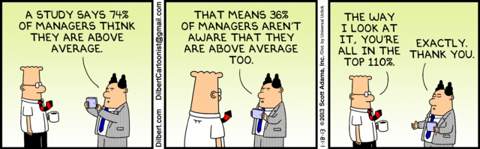
Culture - A word of warning about maturity models
Dunning Kruger Effect - Illusory superiority
In a survey of faculty at the University of Nebraska, 68% rated themselves in the top 25% for teaching ability. - Wikipedia
In a similar survey, 87% of MBA students at Stanford University rated their academic performance as above the median. - Wikipedia
For driving skill, 93% of the US sample and 69% of the Swedish sample put themselves in the top 50% - Wikipedia
How do you think people would rate you as a leader?” It turns out that 74% of the respondents think they’re either above average or the best leader their people have ever had. – SmartBrief on Leadership
@mircohering / http://notafactoryanymore.com

Slide 12
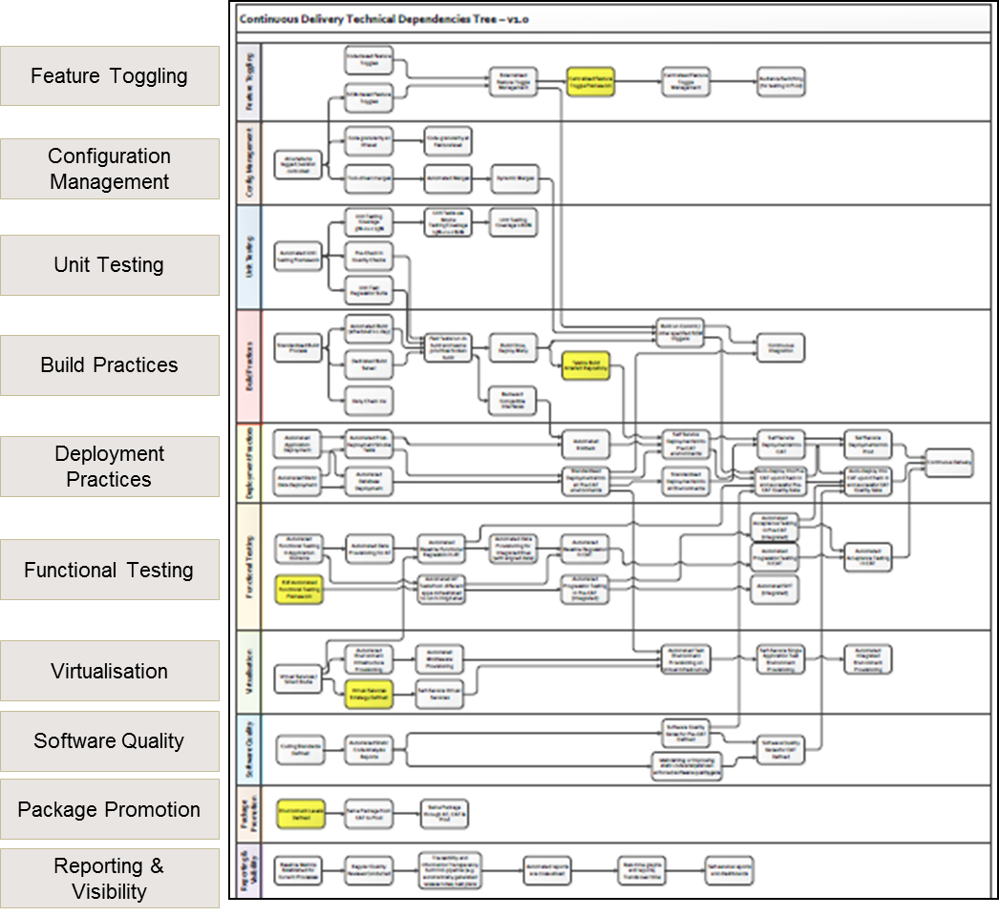
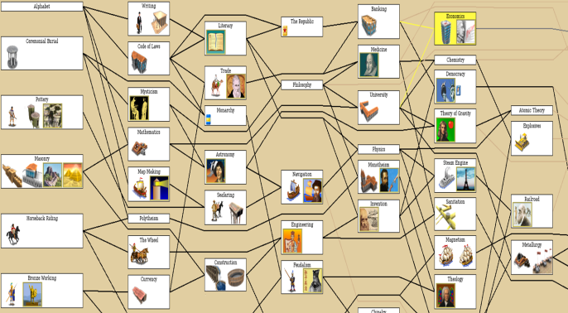
Maturity models and what we can learn from Computer Games
Read more on my blog:
http://notafactoryanymore.com/2015/03/26/what-computer-games-can-teach-us-about-maturity-models-choose-your-own-devops-adventure/
@mircohering / http://notafactoryanymore.com

Slide 13

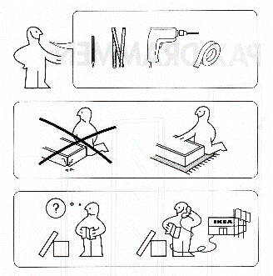
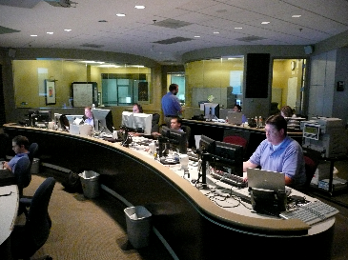

My Simplified View of the DevOps Software Supply Chain
Automation orchestrated
Work Management Process
CMDB
Env 1
Dev Team
Deploy
SCM
Env 2
Check-In
Compile & Package
Package
Deploy
Tailor Env
Deploy
Env 3
Ingredients
Ikea Manual
Operations
@mircohering / http://notafactoryanymore.com

Slide 14
Mirco’s more detailed Reference Model
@mircohering / http://notafactoryanymore.com

Slide 15
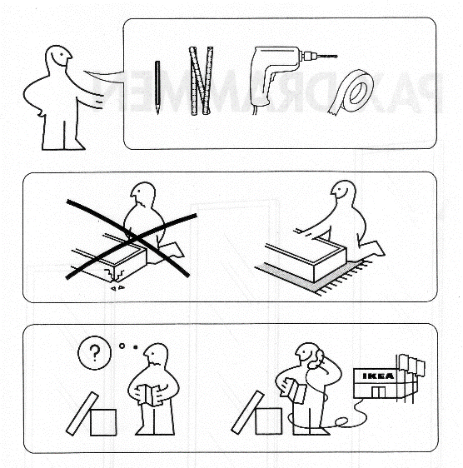
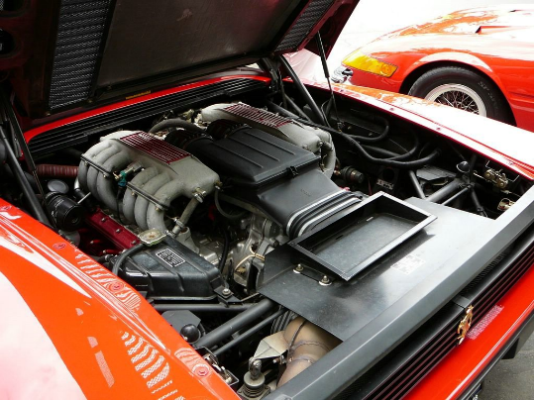

3 Steps for your Systems of Record DevOps Journey
It won’t be easy, but the rewards are worth it!
Only a tool buys a tool to solve this problem…
1. Look under the hood
2. Recreate the IKEA manual
3. Understand the path to production
@mircohering / http://notafactoryanymore.com

Slide 16

Why is COTS software is different
Let’s quickly compare your favourite web language with the usual COTS world
Code Hidden files
Industry standard tools Proprietary
Modular Monolithic
Fast build Long cycle times
Unit Test Not made for unit testing
Developers Configurators
Web-based Test Automation ?!?!?!?
The role of DevOps is to understand how to find the moving pieces.
@mircohering / http://notafactoryanymore.com

Slide 17



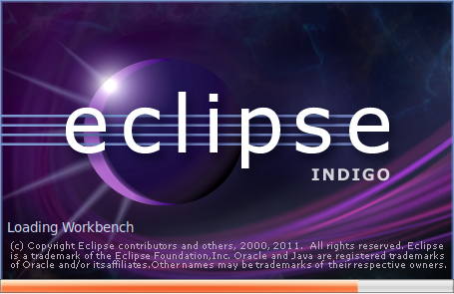
Now that we got code – what next
1. Get it out of the proprietary SCM solution
2. Tightly integrate it with your IDE
3. Solve for Merges
@mircohering / http://notafactoryanymore.com

Slide 18
We did get the results we were hoping for
Our merges took way too long (~2 weeks) and took too much effort
from 100% manual at start
The result: 2 weeks -> 3 days
We removed over 3300 days of manual effort per year across SCM, Build, Package and Deploy
@mircohering / http://notafactoryanymore.com

Slide 19
All is good then with Systems of Record?!? …This is where it comes undone (so far…)
While we made lots of progress, there are still a few work in progress item
Unit test automation
Unsupported activities or no API
Performance
Configuration Management skills – the curse of the configurators
Common Objects
Operations – the last mile…
@mircohering / http://notafactoryanymore.com

Slide 20
Top 5 Takeaways
Many organisations will need to deal with complicated systems of record as part of their DevOps journey
3 simple steps to start the DevOps journey for systems of records
Find the code
Create the IKEA manual
Understand the path to production
To treat SOR code just like any other code
That significant benefits are possible adopting DevOps practices for SORs
That the journey is not complete – but there is hope!
@mircohering / http://notafactoryanymore.com

Slide 21
Here is what I am struggling with
How to create successful partnership between companies and their partners and vendors
How to shift culture at scale
How to safeguard against regression of DevOps progress
How to measure the benefits of DevOps
@mircohering / http://notafactoryanymore.com

Slide 22
Further References
Read more on DevOps
Blog about this talk:
http://devops.com/2015/10/13/devops-systems-record-new-hope-preview-talk/
Mirco’s blogs:
http://notafactoryanymore.com
http://notafactoryanymore.com/2015/01/28/how-to-support-multi-speed-it-with-devops-and-agile/
http://notafactoryanymore.com/2015/03/26/what-computer-games-can-teach-us-about-maturity-models-choose-your-own-devops-adventure/
Accenture’s DevOps offering and reference material:
http://www.accenture.com/devops
How Accenture can help (youtube): https://www.youtube.com/watch?v=n7YGGVb9lhA
@mircohering / http://notafactoryanymore.com

